Slide 1
Module 1 Introduction to number theory and basic cryptography

Slide 2
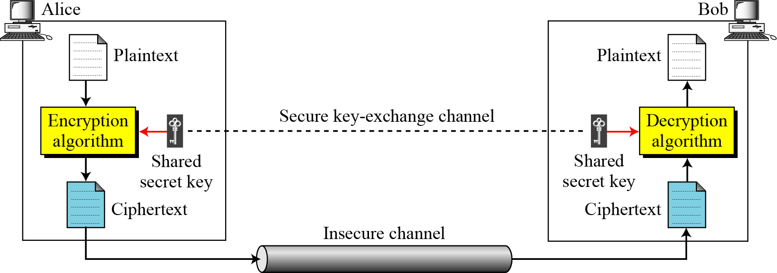
Symmetric Cipher Model
Fig.1. Simplified Model of Symmetric Encryption

Slide 3
Symmetric Cipher Model
Plaintext: This is the original intelligible message or data that is fed into the algorithm as input.
Encryption algorithm: The encryption algorithm performs various substitutions and transformations on the plaintext.
Secret key: The secret key is also input to the encryption algorithm. The key is a value independent of the plaintext and of the algorithm. The algorithm will produce a different output depending on the specific key being used at the time. The exact substitutions and transformations performed by the algorithm depend on the key.

Slide 4
Symmetric Cipher Model
Ciphertext: This is the scrambled message produced as output. It depends on the plaintext and the secret key. For a given message, two different keys will produce two different ciphertexts. The ciphertext is an apparently random stream of data and, as it stands, is unintelligible.
Decryption algorithm: This is essentially the encryption algorithm run in reverse. It takes the ciphertext and the secret key and produces the original plaintext.

Slide 5
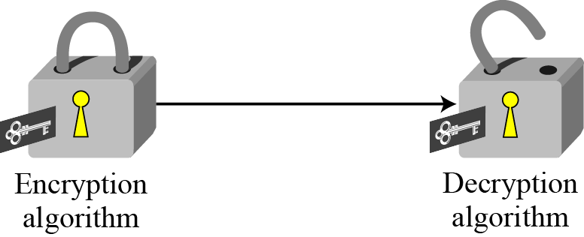
Symmetric Cipher Model
Fig.2. Locking and unlocking with the same key

Slide 6
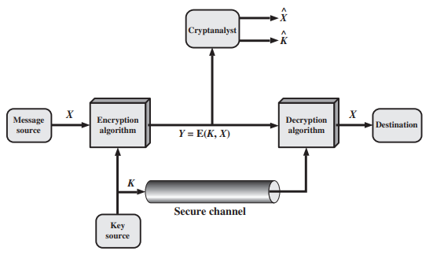
Symmetric Cipher Model
Fig.3. Model of Symmetric Cryptosystem

Slide 7
Cryptanalysis Attack
Typically, the objective of attacking an encryption system is to recover the key in use rather than simply to recover the plaintext of a single ciphertext. There are two general approaches to attacking a conventional encryption scheme:
Cryptanalysis: Cryptanalytic attacks rely on the nature of the algorithm plus perhaps some knowledge of the general characteristics of the plaintext or even some sample plaintext–ciphertext pairs. This type of attack exploits the characteristics of the algorithm to attempt to deduce a specific plaintext or to deduce the key being used.

Slide 8
Types of Cryptanalysis Attacks
Ciphertext-Only Analysis (COA) : In this type of attack, only some cipher-text is known and the attacker tries to find the corresponding encryption key and plaintext. Its the hardest to implement but is the most probable attack as only ciphertext is required.
Known-Plaintext Analysis (KPA) : In this type of attack, some plaintext-ciphertext pairs are already known. Attacker maps them in order to find the encryption key. This attack is easier to use as a lot of information is already available.

Slide 9
Types of Cryptanalysis Attacks
Chosen-Plaintext Analysis (CPA) : In this type of attack, the attacker chooses random plaintexts and obtains the corresponding ciphertexts and tries to find the encryption key. Its very simple to implement like KPA but the success rate is quite low.
Man-In-The-Middle (MITM) attack : In this type of attack, attacker intercepts the message/key between two communicating parties through a secured channel.
Adaptive Chosen-Plaintext Analysis (ACPA) : This attack is similar CPA. Here, the attacker requests the cipher texts of additional plaintexts after they have ciphertexts for some texts.

Slide 10
Brute-force Attacks
Brute-force attack: The attacker tries every possible key on a piece of ciphertext until an intelligible translation into plaintext is obtained. On average, half of all possible keys must be tried to achieve success.
If either type of attack succeeds in deducing the key, the effect is catastrophic: All future and past messages encrypted with that key are compromised.

Slide 11
Types of Brute-force Attacks
Dictionary attacks – surmises usernames or passwords utilizing a dictionary of potential strings or phrases.
Reverse brute force attack – utilizes a typical password or assortment of passwords against numerous conceivable usernames. Focuses on a network of clients for which the attackers have recently acquired information.
Hybrid brute force attacks – begins from outer rationale to figure out which password variety might be destined to succeed, and afterward proceeds with the simple way to deal with attempt numerous potential varieties.
Simple brute force attack – utilizes an efficient way to deal with ‘surmise’ that doesn’t depend on outside rationale.

Slide 12
Substitution Techniques
The two basic building blocks of all encryption techniques are substitution and transposition.
A substitution technique is one in which the letters of plaintext are replaced by other letters or by numbers or symbols.1 If the plaintext is viewed as a sequence of bits, then substitution involves replacing plaintext bit patterns with ciphertext bit patterns.

Slide 13
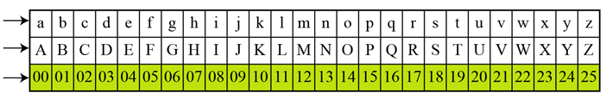
Caesar Cipher
The simplest substitution cipher is the caesar cipher. This cipher is sometimes called a shift cipher and sometimes a additive cipher.
The Caesar cipher involves replacing each letter of the alphabet with the letter standing three places further down the alphabet.
Fig.4. Plaintext in Z₂₆
Plaintext
Value

Slide 14
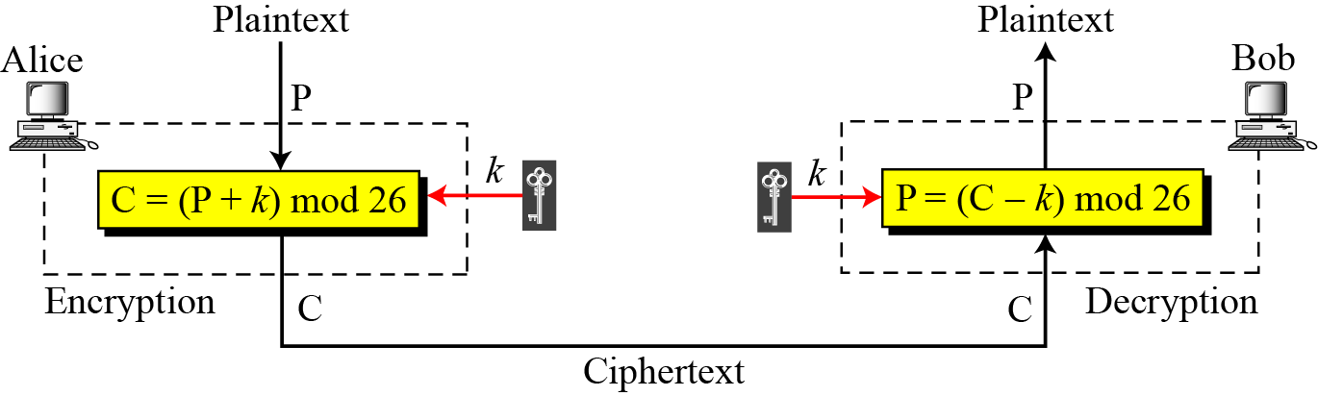
Caesar Cipher
Fig.5. Caesar Cipher
Note:
When the cipher is additive, the plaintext, ciphertext, and key are integers in Z₂₆.

Slide 15
Caesar Cipher
Example:
Use the caesar cipher with k = 15 to encrypt the message “hello”.
Solution:
We apply encryption algorithm to the plaintext, character by character:

Slide 16
Caesar Cipher
Example:
Use the caesar cipher with k = 15 to decrypt the message “WTAAD”.
Solution:
We apply decryption algorithm to the cipher text, character by character:

Slide 17
Monoalphabetic Substitution Cipher
In monoalphabetic substitution, the relationship between a symbol in the plaintext to a symbol in the ciphertext is always one-to-one.
With only 25 possible keys, the Caesar cipher is far from secure.
An increase in the key space can be achieved by allowing an arbitrary substitution.
If, instead, the “cipher” line can be any permutation of the 26 alphabetic characters, then there are 26! or greater than 4 * 10²⁶ possible keys.

Slide 18
Monoalphabetic Substitution Cipher
Fig.6. An example key for monoalphabetic cipher
Example:
Encrypt the below message using the key in Fig.6.
Plaintext: this message is easy to encrypt but hard to find the key.
Ciphertext: ICFV QRVVNER FV RNVS IY RGAHSLI OJI CNHT IY BFGT ICR XRS.

Slide 19
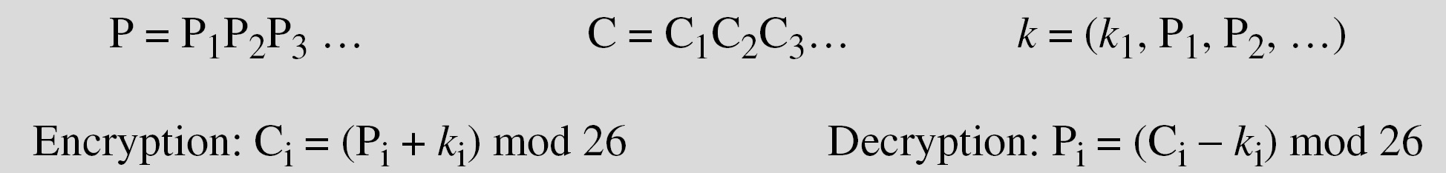
Polyalphabetic Substitution Cipher
In polyalphabetic substitution, each occurrence of a character may have a different substitute. The relationship between a character in the plaintext to a character in the ciphertext is one-to-many.
Playfair and Vignere cipher are polyalphabetic substitution ciphers.

Slide 20
Playfair Cipher
The best-known multiple-letter encryption cipher is the Playfair, which treats diagraps in the plaintext as single units and translates these units into ciphertext digrams.3 The Playfair algorithm is based on the use of a 5 * 5 matrix of letters constructed using a keyword.
Table.1. Example of secret key in Playfair cipher
M | O | N | A | R
C | H | Y | B | D
E | F | G | I/J | K
L | P | Q | S | T
U | V | W | X | Z

Slide 21
Playfair Cipher
In this case, the keyword is monarchy. The matrix is constructed by filling in the letters of the keyword (minus duplicates) from left to right and from top to bottom, and then filling in the remainder of the matrix with the remaining letters in alphabetic order.
The letters I and J count as one letter.
Plaintext is encrypted two letters at a time, according to the following rules:
1. Repeating plaintext letters that are in the same pair are separated with a filler letter, such as x, so that balloon would be treated as ba lx lo on.
2. Two plaintext letters that fall in the same row of the matrix are each replaced by the letter to the right, with the first element of the row circularly following the last. For example, ar is encrypted as RM.

Slide 22
Playfair Cipher
3. Two plaintext letters that fall in the same column are each replaced by the letter beneath, with the top element of the column circularly following the last. For example, mu is encrypted as CM.
4. Otherwise, each plaintext letter in a pair is replaced by the letter that lies in its own row and the column occupied by the other plaintext letter. Thus, hs becomes BP and ea becomes IM (or JM, as the encipherer wishes).

Slide 23
Playfair Cipher
Example:
Plaintext : jazz
Plaintext : greet
Plaintext : playing
ja
zx
zz
zx
gr
gr
ee
ex
t
et
pl
ay
in
gz

Slide 24
Playfair Cipher
Example:
Let us encrypt the plaintext “instruments” using the key in table.1
in -> ga st -> tl ru -> mz me -> cl
nt -> rq sz -> tx
Plaintext : instruments Ciphertext : gatlmzclrqtx
M | O | N | A | R
C | H | Y | B | D
E | F | G | I/J | K
L | P | Q | S | T
U | V | W | X | Z

Slide 25
Playfair Cipher
Example:
Let us encrypt the plaintext “We should communicate” using the key as “Playfair Example”
we sh ou ld co mx mu ni ca te
we -> vx sh -> zs ou -> nv ld -> ac
co -> dn mx -> im mu -> rz ni -> kr
ca -> dl te -> vi
P | L | A | Y | F
I/J | R | E | X | M
B | C | D | G | H
K | N | O | Q | S
T | U | V | W | Z

Slide 26
Vigenere Cipher
This scheme of cipher uses a text string (say, a word) as a key, which is then used for doing a number of shifts on the plaintext.
We can express the Vigenère cipher as
Plaintext letters P = p₀, p₁, p₂, …, p_{n-1}
Key K = k₀, k₁, k₂, …, k_{m-1}, where typically m < n.
Ciphertext letters C = C₀, C₁, C₂, …, C_{n-1}
Thus, the first letter of the key is added to the first letter of the plaintext, mod 26, the second letters are added, and so on through the first m letters of the plaintext. For the next m letters of the plaintext, the key letters are repeated. This process continues until all of the plaintext sequence is encrypted.

Slide 27
Vigenere Cipher
A general equation of the encryption process is
C_{i} = (p_{i} + k_{i mod m} m)mod 26
Similarly, decryption
p_{i} = (C_{i} - k_{i mod m})mod 26
To encrypt a message, a key is needed that is as long as the message. Usually, the key is a repeating keyword.
Example: We can encrypt the message “She is listening” using the 6-character keyword “PASCAL”.

Slide 28
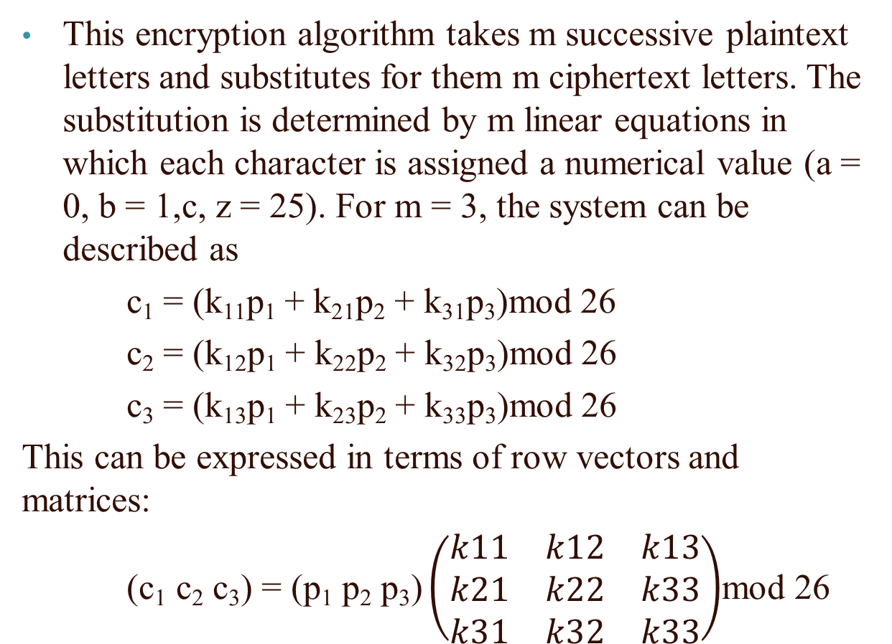
Hill Cipher
This encryption algorithm takes m successive plaintext letters and substitutes for them m ciphertext letters. The substitution is determined by m linear equations in which each character is assigned a numerical value (a = 0, b = 1,c, z = 25). For m = 3, the system can be described as
c₁ = (k₁₁p₁ + k₂₁p₂ + k₃₁p₃)mod 26
c₂ = (k₁₂p₁ + k₂₂p₂ + k₃₂p₃)mod 26
c₃ = (k₁₃p₁ + k₂₃p₂ + k₃₃p₃)mod 26
This can be expressed in terms of row vectors and matrices:
$\text{(}\text{c}\text{1} \text{c}\text{2} \text{c}\text{3}\text{) = (}\text{p}\text{1} \text{p}\text{2} \text{p}\text{3}\text{)}\left(\begin{matrix}k11 & k12 & k13 \\ k21 & k22 & k33 \\ k31 & k32 & k33\end{matrix}\right)$mod 26

Slide 29
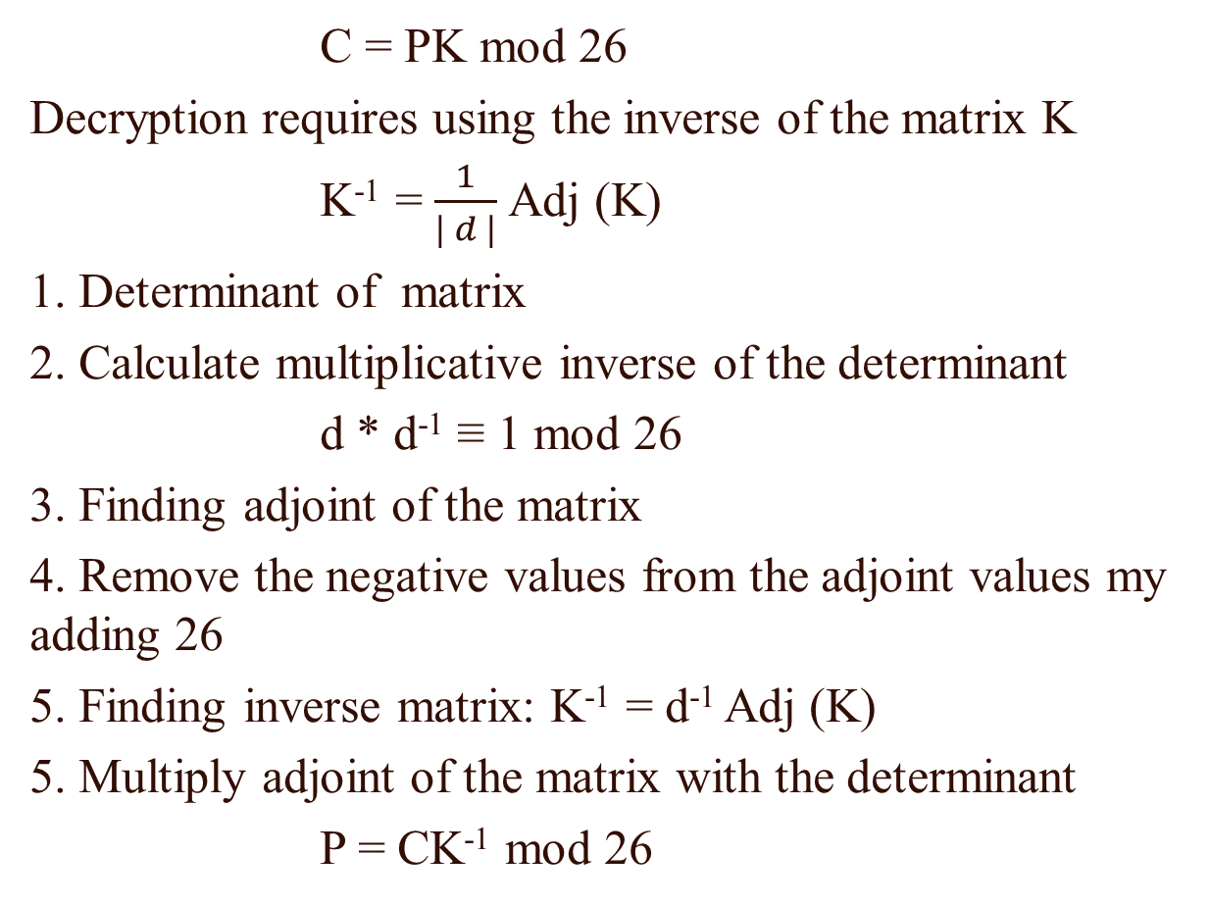
Hill Cipher
C = PK mod 26
Decryption requires using the inverse of the matrix K
K⁻¹ = $\frac{1}{| d |}$Adj (K)
1. Determinant of matrix
2. Calculate multiplicative inverse of the determinant
d * d⁻¹ ≡ 1 mod 26
3. Finding adjoint of the matrix
4. Remove the negative values from the adjoint values my adding 26
5. Finding inverse matrix: K⁻¹ = d⁻¹ Adj (K)
5. Multiply adjoint of the matrix with the determinant
P = CK⁻¹ mod 26

Slide 30
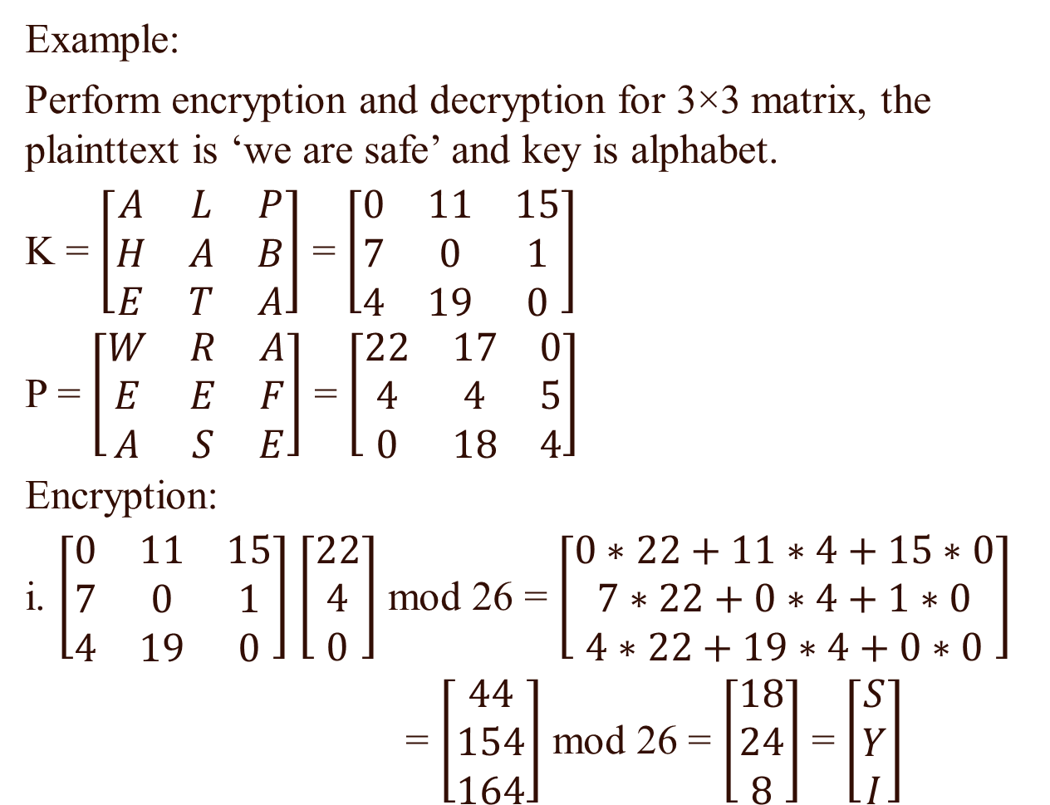
Hill Cipher
Example:
Perform encryption and decryption for 3×3 matrix, the plainttext is ‘we are safe’ and key is alphabet.
K = $\left[\begin{matrix}A & L & P \\ H & A & B \\ E & T & A\end{matrix}\right]$ = $\left[\begin{matrix}0 & 11 & 15 \\ 7 & 0 & 1 \\ 4 & 19 & 0\end{matrix}\right]$
P = $\left[\begin{matrix}W & R & A \\ E & E & F \\ A & S & E\end{matrix}\right]$ = $\left[\begin{matrix}22 & 17 & 0 \\ 4 & 4 & 5 \\ 0 & 18 & 4\end{matrix}\right]$
Encryption:
i. $\left[\begin{matrix}0 & 11 & 15 \\ 7 & 0 & 1 \\ 4 & 19 & 0\end{matrix}\right]$ $\left[\begin{matrix}22 \\ 4 \\ 0\end{matrix}\right]$ mod 26 = $\left[\begin{matrix}0∗22+11∗4+15∗0 \\ 7∗22+0∗4+1∗0 \\ 4∗22+19∗4+0∗0\end{matrix}\right]$
= $\left[\begin{matrix}44 \\ 154 \\ 164\end{matrix}\right]$ mod 26 = $\left[\begin{matrix}18 \\ 24 \\ 8\end{matrix}\right]$ = $\left[\begin{matrix}S \\ Y \\ I\end{matrix}\right]$

Slide 31
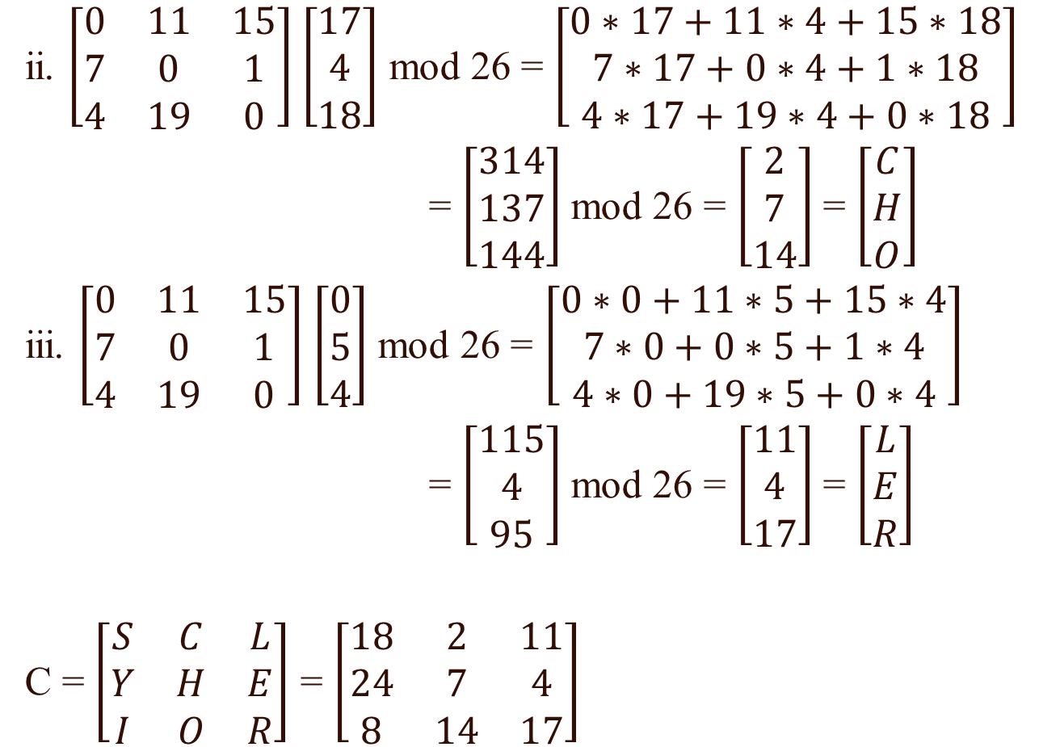
Hill Cipher
ii. $\left[\begin{matrix}0 & 11 & 15 \\ 7 & 0 & 1 \\ 4 & 19 & 0\end{matrix}\right]$ $\left[\begin{aligned}17 \\ 4 \\ 18\end{aligned}\right]$ mod 26 = $\left[\begin{matrix}0∗17+11∗4+15∗18 \\ 7∗17+0∗4+1∗18 \\ 4∗17+19∗4+0∗18\end{matrix}\right]$
= $\left[\begin{matrix}314 \\ 137 \\ 144\end{matrix}\right]$ mod 26 = $\left[\begin{matrix}2 \\ 7 \\ 14\end{matrix}\right]$ = $\left[\begin{matrix}C \\ H \\ O\end{matrix}\right]$
iii. $\left[\begin{matrix}0 & 11 & 15 \\ 7 & 0 & 1 \\ 4 & 19 & 0\end{matrix}\right]$ $\left[\begin{aligned}0 \\ 5 \\ 4\end{aligned}\right]$ mod 26 = $\left[\begin{matrix}0∗0+11∗5+15∗4 \\ 7∗0+0∗5+1∗4 \\ 4∗0+19∗5+0∗4\end{matrix}\right]$
= $\left[\begin{matrix}115 \\ 4 \\ 95\end{matrix}\right]$ mod 26 = $\left[\begin{matrix}11 \\ 4 \\ 17\end{matrix}\right]$ = $\left[\begin{matrix}L \\ E \\ R\end{matrix}\right]$
C = $\left[\begin{matrix}S & C & L \\ Y & H & E \\ I & O & R\end{matrix}\right]$ = $\left[\begin{matrix}18 & 2 & 11 \\ 24 & 7 & 4 \\ 8 & 14 & 17\end{matrix}\right]$

Slide 32
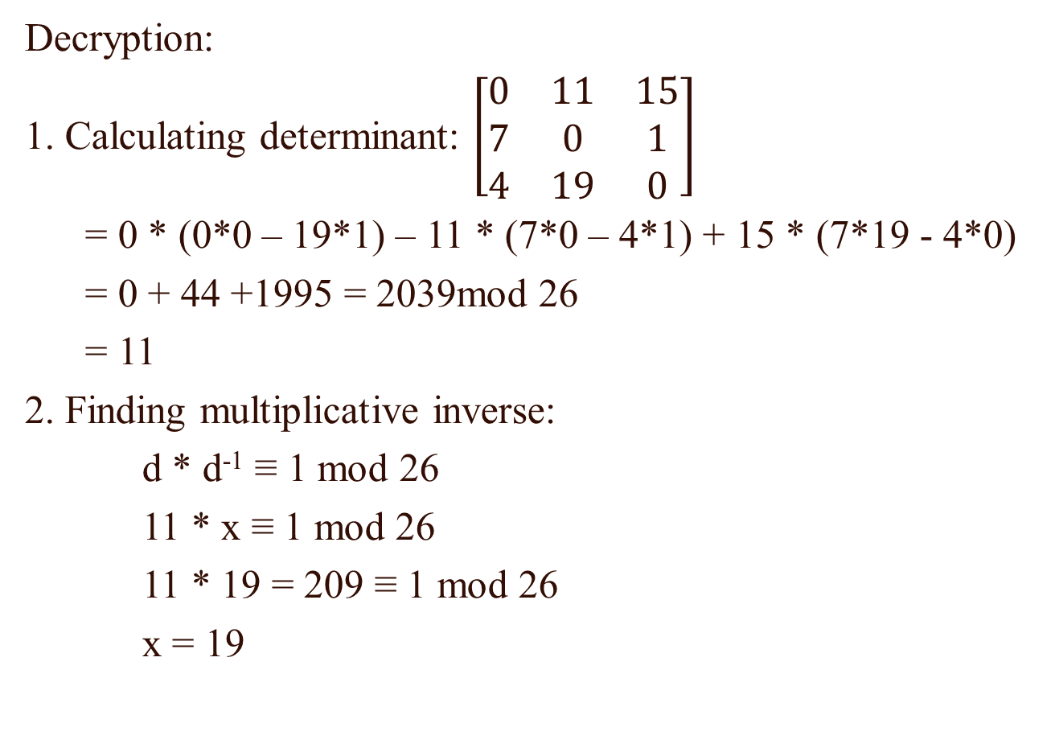
Hill Cipher
Decryption:
1. Calculating determinant: $\left[\begin{matrix}0 & 11 & 15 \\ 7 & 0 & 1 \\ 4 & 19 & 0\end{matrix}\right]$
= 0 * (0*0 – 19*1) – 11 * (7*0 – 4*1) + 15 * (7*19 - 4*0)
= 0 + 44 +1995 = 2039mod 26
= 11
2. Finding multiplicative inverse:
d * d⁻¹ ≡ 1 mod 26
11 * x ≡ 1 mod 26
11 * 19 = 209 ≡ 1 mod 26
x = 19

Slide 33
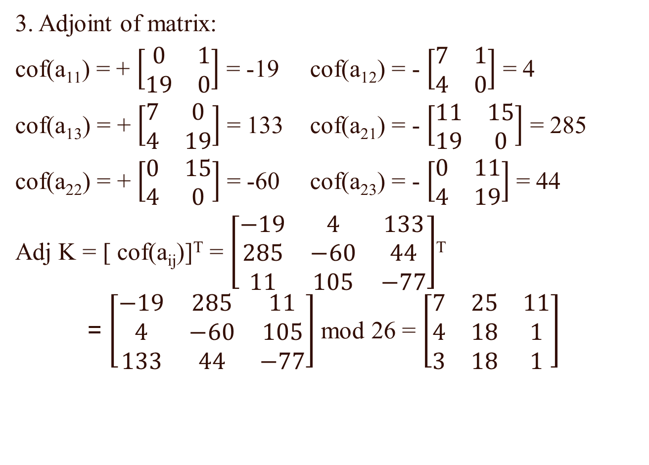
Hill Cipher
3. Adjoint of matrix:
cof(a₁₁) = + $\left[\begin{matrix}0 & 1 \\ 19 & 0\end{matrix}\right]$ = -19 cof(a₁₂) = - $\left[\begin{matrix}7 & 1 \\ 4 & 0\end{matrix}\right]$ = 4
cof(a₁₃) = + $\left[\begin{matrix}7 & 0 \\ 4 & 19\end{matrix}\right]$ = 133 cof(a₂₁) = - $\left[\begin{matrix}11 & 15 \\ 19 & 0\end{matrix}\right]$ = 285
cof(a₂₂) = + $\left[\begin{matrix}0 & 15 \\ 4 & 0\end{matrix}\right]$ = -60 cof(a₂₃) = - $\left[\begin{matrix}0 & 11 \\ 4 & 19\end{matrix}\right]$ = 44
Adj K = [ cof(a_{ij})]^{T} = $\left[\begin{matrix}−19 & 4 & 133 \\ 285 & −60 & 44 \\ 11 & 105 & −77\end{matrix}\right]$^{T} = $\left[\begin{matrix}−19 & 285 & 11 \\ 4 & −60 & 105 \\ 133 & 44 & −77\end{matrix}\right]$ mod 26 = $\left[\begin{matrix}7 & 25 & 11 \\ 4 & 18 & 1 \\ 3 & 18 & 1\end{matrix}\right]$

Slide 34
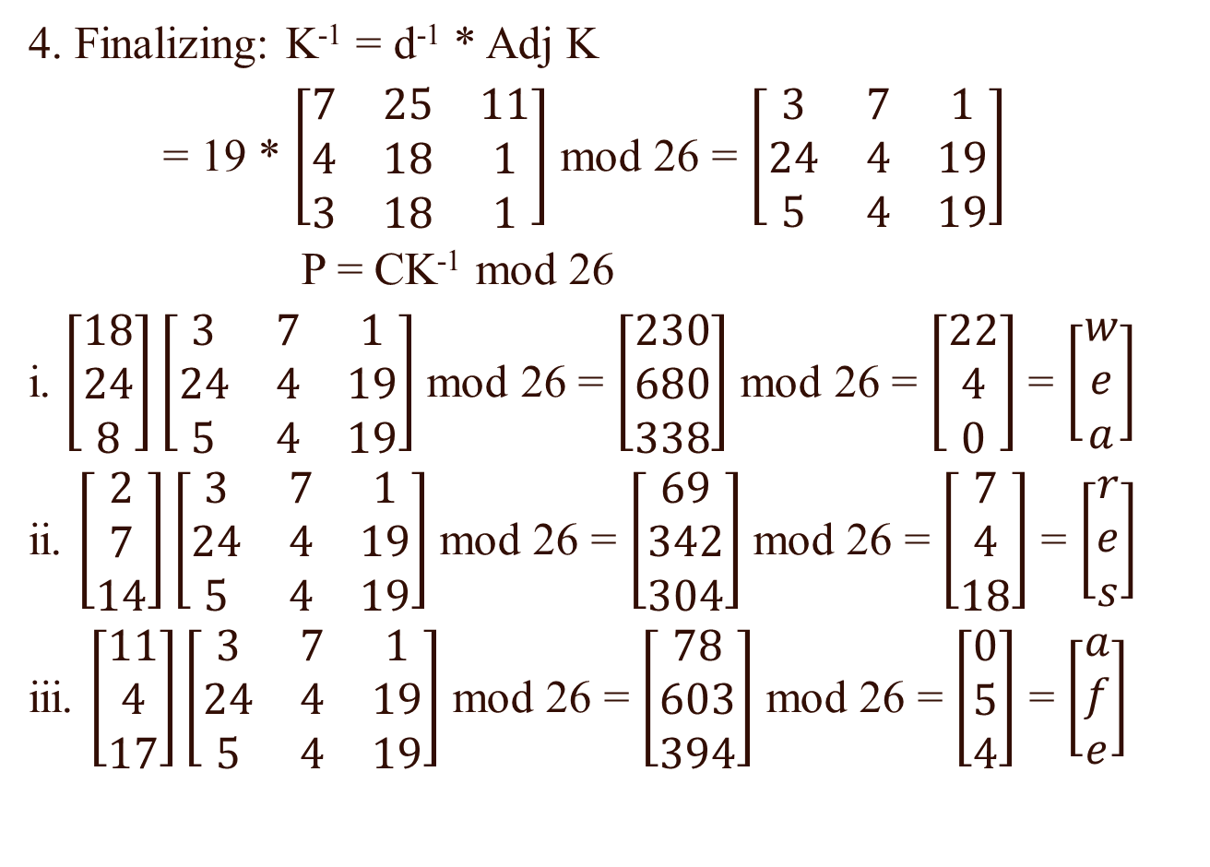
Hill Cipher
4. Finalizing: K⁻¹ = d⁻¹ * Adj K
= 19 * $\left[\begin{matrix}7 & 25 & 11 \\ 4 & 18 & 1 \\ 3 & 18 & 1\end{matrix}\right]$ mod 26 = $\left[\begin{matrix}3 & 7 & 1 \\ 24 & 4 & 19 \\ 5 & 4 & 19\end{matrix}\right]$
P = CK⁻¹ mod 26
i. $\left[\begin{aligned}18 \\ 24 \\ 8\end{aligned}\right]\left[\begin{matrix}3 & 7 & 1 \\ 24 & 4 & 19 \\ 5 & 4 & 19\end{matrix}\right]$ mod 26 = $\left[\begin{matrix}230 \\ 680 \\ 338\end{matrix}\right]$ mod 26 = $\left[\begin{matrix}22 \\ 4 \\ 0\end{matrix}\right]$ = $\left[\begin{matrix}w \\ e \\ a\end{matrix}\right]$
ii. $\left[\begin{aligned}2 \\ 7 \\ 14\end{aligned}\right]\left[\begin{matrix}3 & 7 & 1 \\ 24 & 4 & 19 \\ 5 & 4 & 19\end{matrix}\right]$ mod 26 = $\left[\begin{matrix}69 \\ 342 \\ 304\end{matrix}\right]$ mod 26 = $\left[\begin{matrix}7 \\ 4 \\ 18\end{matrix}\right]$ = $\left[\begin{matrix}r \\ e \\ s\end{matrix}\right]$
iii. $\left[\begin{aligned}11 \\ 4 \\ 17\end{aligned}\right]\left[\begin{matrix}3 & 7 & 1 \\ 24 & 4 & 19 \\ 5 & 4 & 19\end{matrix}\right]$ mod 26 = $\left[\begin{matrix}78 \\ 603 \\ 394\end{matrix}\right]$ mod 26 = $\left[\begin{matrix}0 \\ 5 \\ 4\end{matrix}\right]$ = $\left[\begin{matrix}a \\ f \\ e\end{matrix}\right]$

Slide 35
Transposition Ciphers
A transposition cipher does not substitute one symbol for another, instead it changes the location of the symbols.
A transposition cipher reorders symbols.
Transposition ciphers can be:
1. Keyless Transposition Ciphers
2. Keyed Transposition Ciphers

Slide 36
Keyless Transposition Ciphers
Simple transposition ciphers, which were used in the past, are keyless.
Rail-Fence:
A good example of a keyless cipher is the rail fence cipher. The plaintext is written down as a sequence of diagonals and the ciphertext is created reading the pattern row by row. For example, to send the message “Meet me at the park” with a rail fence with depth 2,
The ciphertext “MEMATEAKETETHPR”.

Slide 37

Keyless Transposition Ciphers
For the plaintext we used above, "defend the east wall", with a key of 3, we get the encryption process shown below.
Example : For the plaintext, "defend the east wall", with a key of 3, we get the encryption process shown below.
The ciphertext “DNETLEEDHESWLXFTAAX”.
Example: If ciphertext = “TIETSHSSSCEMSAEIAREG”, key = 3, find the plaintext.
T |  |  |  | I |  |  |  | E |  |  |  | T |  |  |  | S
 | - |  | - |  | - |  | - |  | - |  | - |  | - |  | - |  | - |  | -
 |  | - |  |  |  | - |  |  |  | - |  |  |  | - |  |  |  | -

Slide 38
Keyless Transposition Ciphers
For the plaintext we used above, "defend the east wall", with a key of 3, we get the encryption process shown below.
“TIETSHSSSCEMSAEIAREG”
Q: If ciphertext = “TEKOOHRACIRMNREATANFTETYTGHH”, key = 4, find the plaintext.
T |  |  |  | I |  |  |  | E |  |  |  | T |  |  |  | S
 | H |  | S |  | S |  | S |  | C |  | E |  | M |  | S |  | A |  | E
 |  | - |  |  |  | - |  |  |  | - |  |  |  | - |  |  |  | -
T |  |  |  | I |  |  |  | E |  |  |  | T |  |  |  | S
 | H |  | S |  | S |  | S |  | C |  | E |  | M |  | S |  | A |  | E
 |  | I |  |  |  | A |  |  |  | R |  |  |  | E |  |  |  | G

Slide 39
Keyed Transposition Ciphers
For the plaintext we used above, "defend the east wall", with a key of 3, we get the encryption process shown below.
The keyless ciphers permute the characters by using writing plaintext in one way and reading it in another way The permutation is done on the whole plaintext to create the whole ciphertext. Another method is to divide the plaintext into groups of predetermined size, called blocks, and then use a key to permute the characters in each block separately.
Columnar transposition:
A more complex scheme is to write the message in a rectangle, row by row, and read the message off, column by column, but permute the order of the columns. The order of the columns then becomes the key to the algorithm.

Slide 40

Keyed Transposition Ciphers
For the plaintext we used above, "defend the east wall", with a key of 3, we get the encryption process shown below.
Example: Encrypt the message “Enemy attacks tonight”.
Key:
Key:
Plaintext:
Ciphertext: ETTHEAKIMAOTYCNZNTSG
$$\begin{matrix}2 & 5 & 1 & 3 & 4 \\ e & n & e & m & y \\ a & t & t & a & c \\ k & s & t & o & n \\ i & g & h & t & z\end{matrix}$$

Slide 41
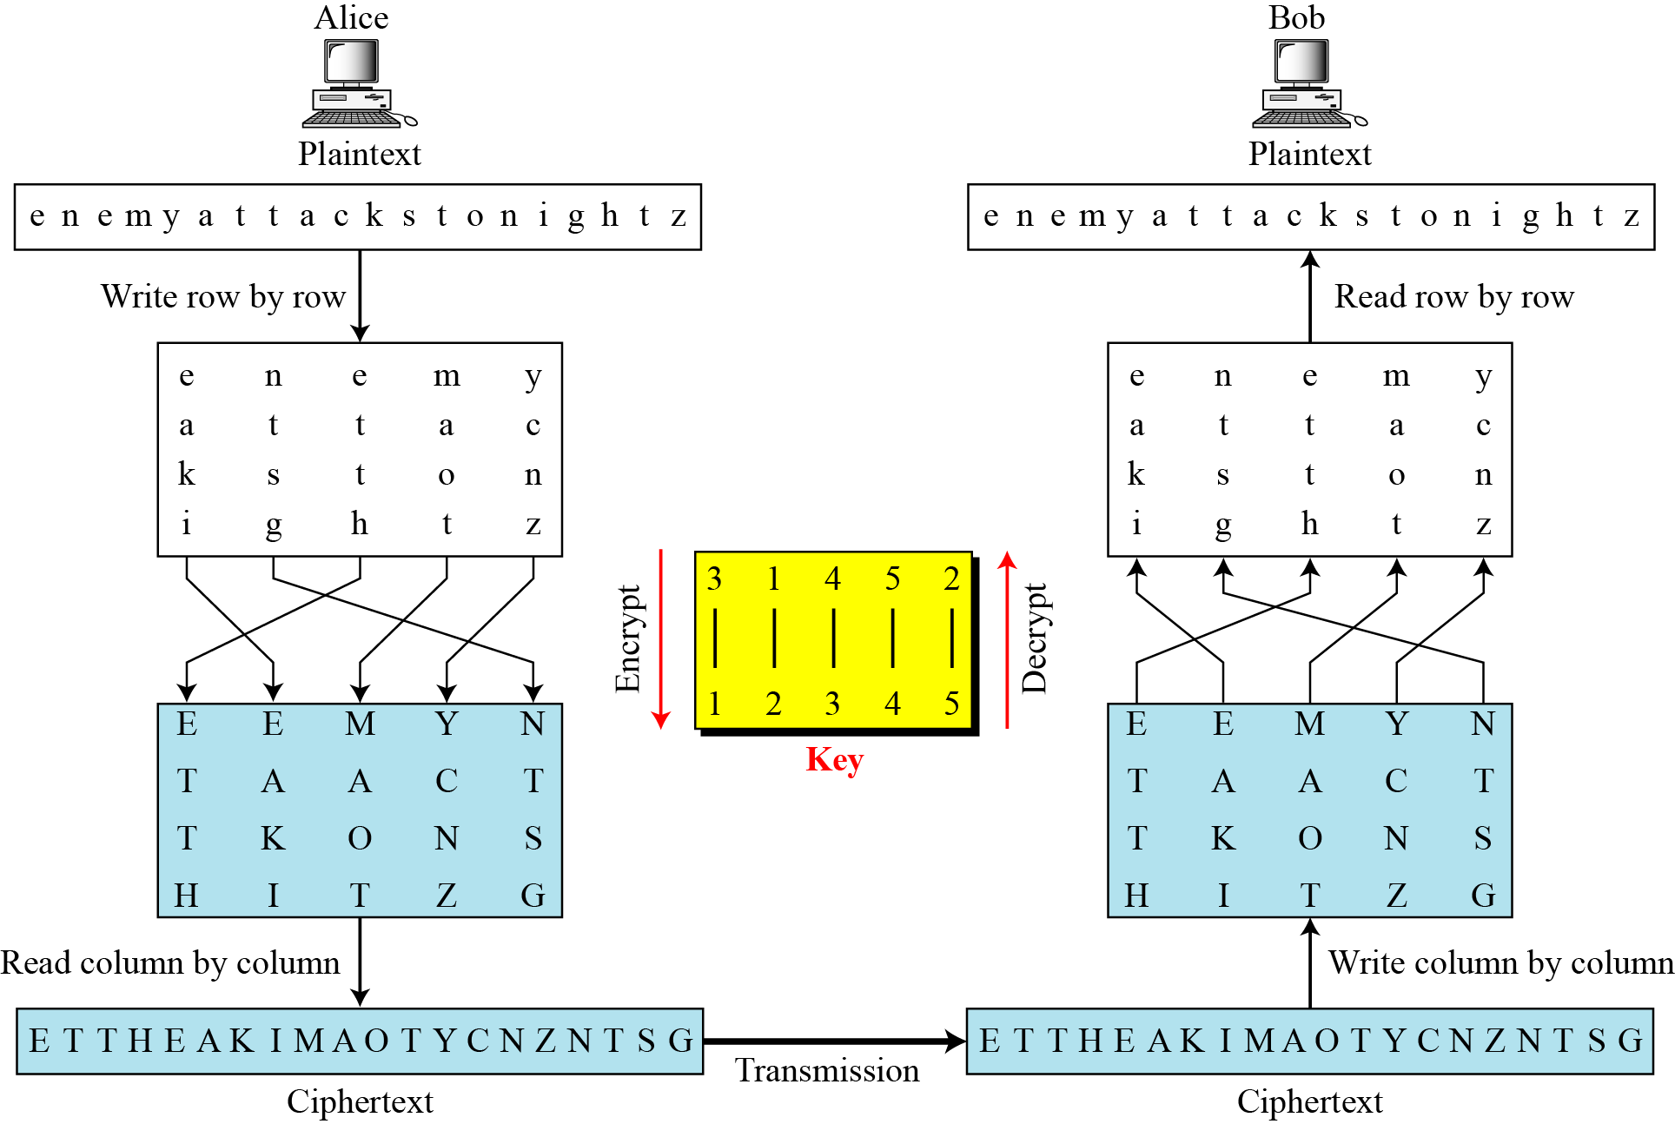
Keyed Transposition Ciphers
For the plaintext we used above, "defend the east wall", with a key of 3, we get the encryption process shown below.

Slide 42

Keyed Transposition Ciphers
For the plaintext we used above, "defend the east wall", with a key of 3, we get the encryption process shown below.
Example: Encrypt the message “computer network”.
Key: LAYER ----- 31524
Key:
Plaintext: $\left.\begin{matrix}L & A & Y & E & R \\ 3 & 1 & 5 & 2 & 4 \\ c & o & m & p & u \\ t & e & r & n & e \\ t & w & o & r & k\end{matrix}\right.$
Ciphertext: OEWPNRCTTUEKMRO

Slide 43
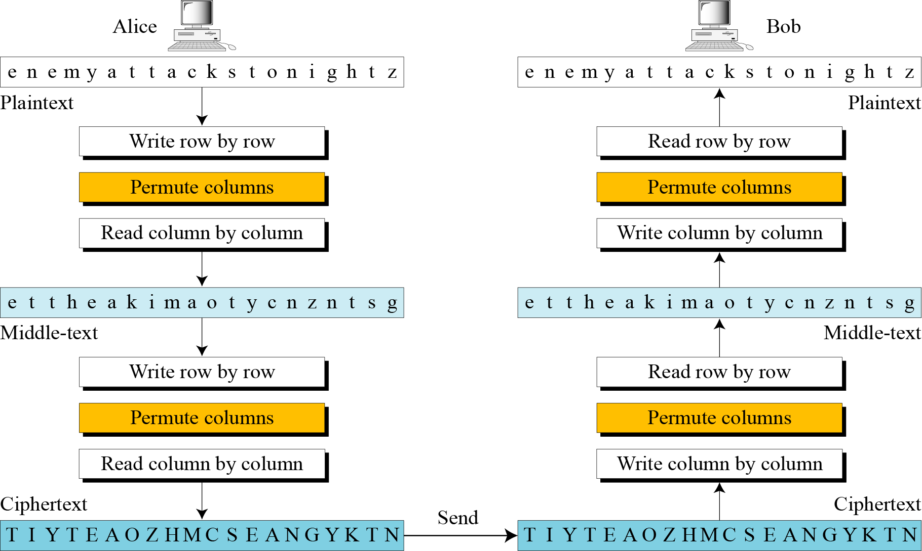
Double Transposition Ciphers
For the plaintext we used above, "defend the east wall", with a key of 3, we get the encryption process shown below.

